Slide 1
Theory of Automata
بِسْمِ اللهِ الرَّحْمٰنِ الرَّحِيْمِ
Lecture # 06
Imtiaz Ahmed

Slide 2
Deterministic Finite Automata
Also known as Finite state machine, Finite state automata
It represents an abstract machine which is used to represent a regular language
A regular expression can also be represented using Finite Automata
There are two ways to specify an FA: Directed Graphs and Transition Tables.

Slide 3
Finite Automata Informal Definition
An FA may be defined as follows:-
Finite no of states in which one state must be initial state and more than one or may be none can be the final states.
Sigma Σ provides the input letters from which input strings can be formed.
FA Distinguishing Rule: For each state, there must be an out going transition for each input letter in Sigma Σ.

Slide 4
Example
Σ = {a,b} and states = 0,1,2 where 0 is an initial state and 2 is the final state.
Transitions:
At state 0 reading a,b go to state 1,
At state 1 reading a, b go to state 2
At state 2 reading a, b go to state 2

Slide 5
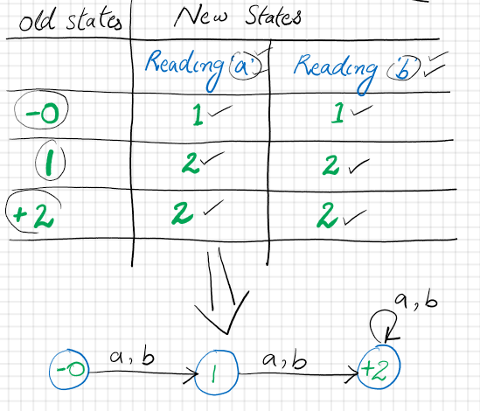
Transition Table for The Given FA

Slide 6
Home Work
Σ = {a,b} and states = 0,1,2 where 0 is an initial state and 2 is the final state.
Transitions:
At state 0 reading a go to state 1,
At state 0 reading b go to state 2,
At state 1 reading a,b go to state 2
At state 2 reading a, b go to state 2
Draw Transition Table and Transition Graph / FA for above.

Slide 7
Thanks!
Any question?

